Slide 1
Discrete Mathematics
South China University of Technology
1

Slide 2
Chapter 10. Trees
Applications of Trees
Section 10.2
2

Slide 3
Contents
1
Binary Searching Trees
2
Decision Trees
3
Prefix Codes
4
Game Trees
3

Slide 4
§9.2: Applications of Trees
Binary search trees
A simple data structure for sorted lists
Decision trees
Minimum comparisons in sorting algorithms
Prefix codes
Huffman coding
Game trees

Slide 5
Binary Searching Trees
5

Slide 6
Binary Search Trees
A representation for sorted sets of items.
Supports the following operations in Θ(log n) average-case time:
Searching for an existing item.
Inserting a new item, if not already present.
Supports printing out all items in Θ(n) time.
Note that inserting into a plain sequence a_{i} would instead take Θ(n) worst-case time.

Slide 7
Binary Search Tree Format
Items are stored at individual tree nodes.
We arrange for the tree to always obey this invariant:
For every item x, Every node in x’s left subtree is less than x.
Every node in x’s right subtree is greater than x.
Example:
7
3
12
1
5
9
15
0
2
8
11

Slide 8
Recursive Binary Tree Insert
procedure insert(T: binary tree, x: item) v := root[T] if v = null then begin root[T] := x; return “Done” end else if v = x return “Already present” else if x < v then return insert(leftSubtree[T], x) else {must be x > v} return insert(rightSubtree[T], x)

Slide 9
Example 1
Mathematics
1 Physics > Mathematics
2 Geog.<Math.
Geography
3 Zoology > Math.
Zoology > Physics
Physics
Geology
Zoology
4 Mete. > Math.
Mete. < Physics
Meteorology
5 Geol. < Math.
Geol. > Geog.
Psychology
6 Psyc. > Math.
Psyc. > Phys.
Psyc. < Zoology

Slide 10
Decision Trees
10

Slide 11
Decision Trees (pp. 646-649)
A decision tree represents a decision-making process.
node : a possible “decision point” or situation.
edge : a possible choice that could be made at that decision point is represented by an edge to a child node.
In the extended decision trees used in decision analysis, we also include nodes that represent random events and their outcomes.

Slide 12
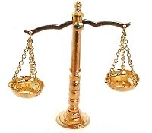
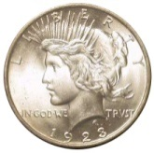
Coin-Weighing Problem
Imagine you have 8 coins, one of which is a lighter counterfeit
仿制品,
and a free-beam balance.
No scale of weight markings is required for this problem!
How many weightings are needed to guarantee that the counterfeit coin will be found?
?

Slide 13
As a Decision-Tree Problem
In each situation, we pick two disjoint and equal-size subsets of coins to put on the scale.
The balance then “decides” whether to tip left, tip right, or stay balanced.
A given sequence of weighings thus yields a decision tree with branching factor 3.

Slide 14
Applying the Tree Height Theorem
The decision tree must have at least 8 leaf nodes, since there are 8 possible outcomes.
In terms of which coin is the counterfeit one.
Recall the tree-height theorem, h≥⎡log_{m}⎤.
Thus the decision tree must have height h ≥ ⎡log₃8⎤ = ⎡1.893…⎤ = 2.
Let’s see if we solve the problem with only 2 weighings…

Slide 15
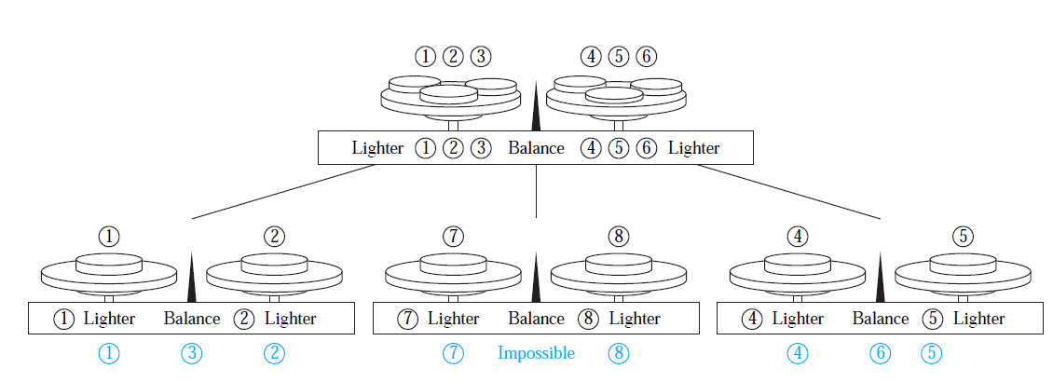

Slide 16
A Decision Tree for Sorting
Sort(a, b,c)：
a : b
a>b
b>a
a : c
b : c
a>c
a<c
b>c
b<c
b : c
c>a>b
a : c
c>b>a
b>c
b<c
a>c
a<c
a>b>c
a>c>b
b>a>c
b>c>a

Slide 17
Theorem 1
Theorem 1: A sorting algorithm Sort(a₁, a₂,... a_{n}) based on binary comparison requires at least ⎡log n!⎤ comparisons.
Proof : The complexity of a sort based on binary comparisons is measured in terms of the number of such comparisons used.
The largest number of comparisons ever needed is equal to the height of the decision tree.

Slide 18
Proof of Theorem 1
The binary decision tree has n! leaves.
Its height is h≥ ⎡log n!⎤.
at least ≥ ⎡log n!⎤ comparisons are needed.
The proof is finished.
We need note that ⎡log n!⎤ is Θ(n log n), one of the commonly used reference functions for the computational complexity of algorithms.

Slide 19
Game Trees
19

Slide 20
Game Trees
vertices: positions in a game;
edges: legal moves between these position.
root : the starting position.
leaves: the final positions of a game.
Game trees may be infinite when the games they represent never end.

Slide 21
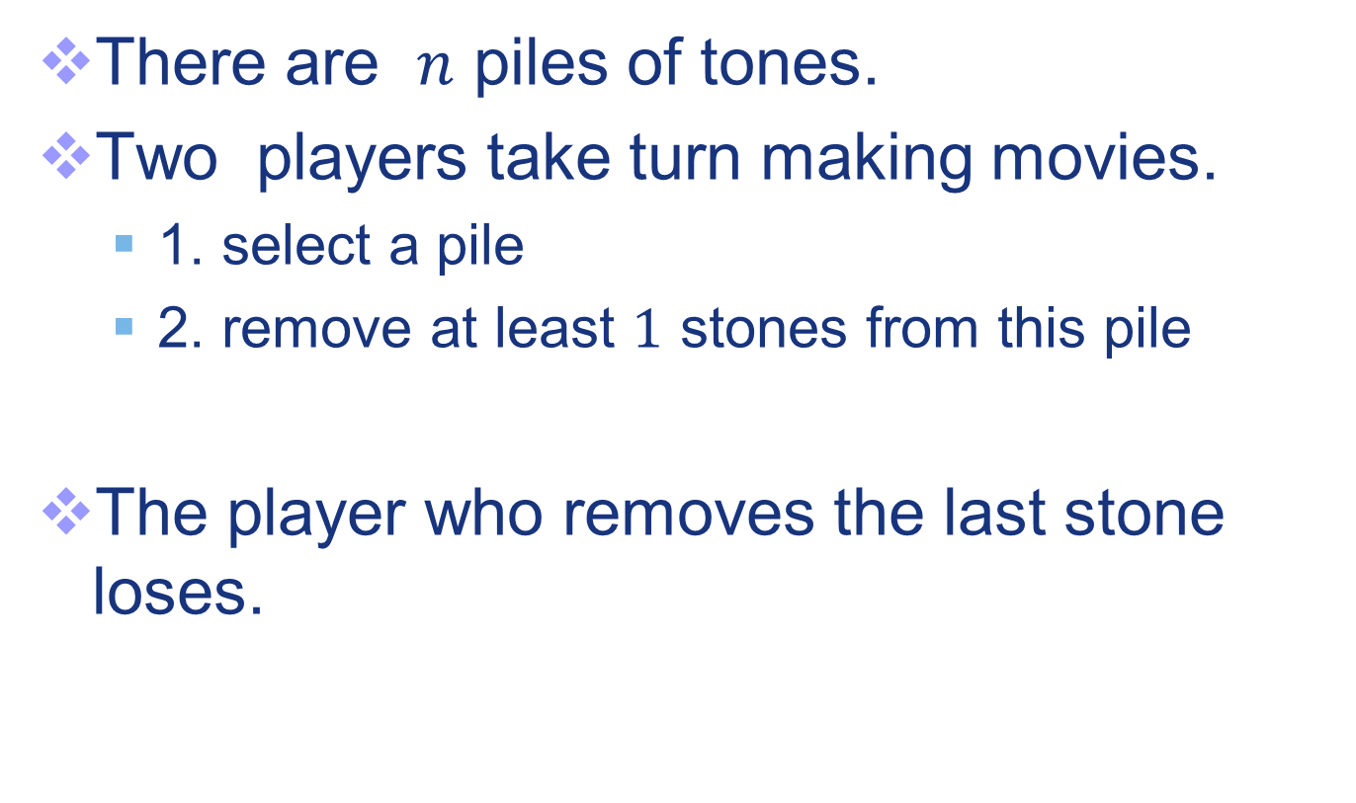
Nim
There are $n$ piles of tones.
Two players take turn making movies.
1. select a pile
2. remove at least $1$ stones from this pile
The player who removes the last stone loses.

Slide 22
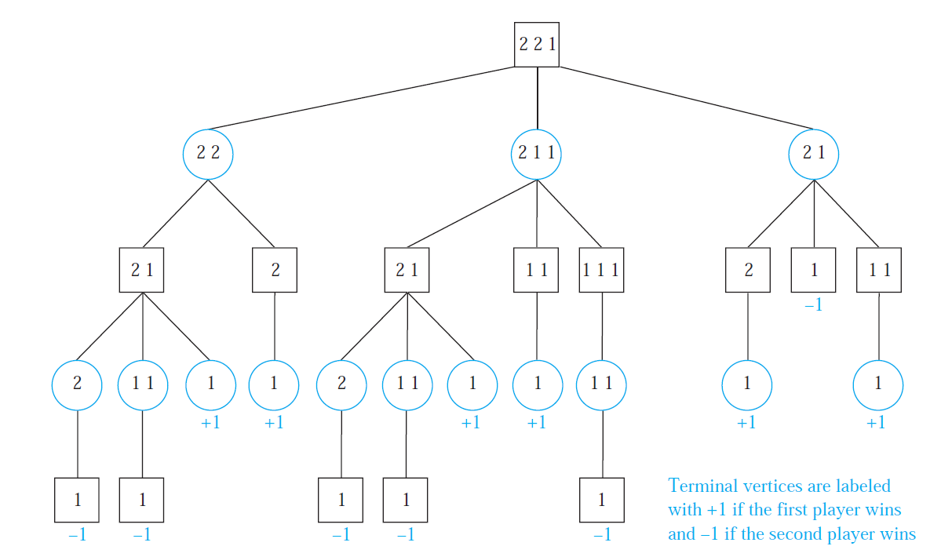

Slide 23
Game Trees
Definition 1: The value of a vertex in a game tree is defined recursively as:
(i) the value of a leaf is the payoff to the first player when the game terminates in the position represented by this leaf.

Slide 25
Game Trees
Definition 1: The value of a vertex in a game tree is defined recursively as:
(ii) the value of an internal vertex:
at even level is the maximum of values of its children,
at an odd level is the minimum of the values of its children.
the value of the root is called the value of the tree.

Slide 26
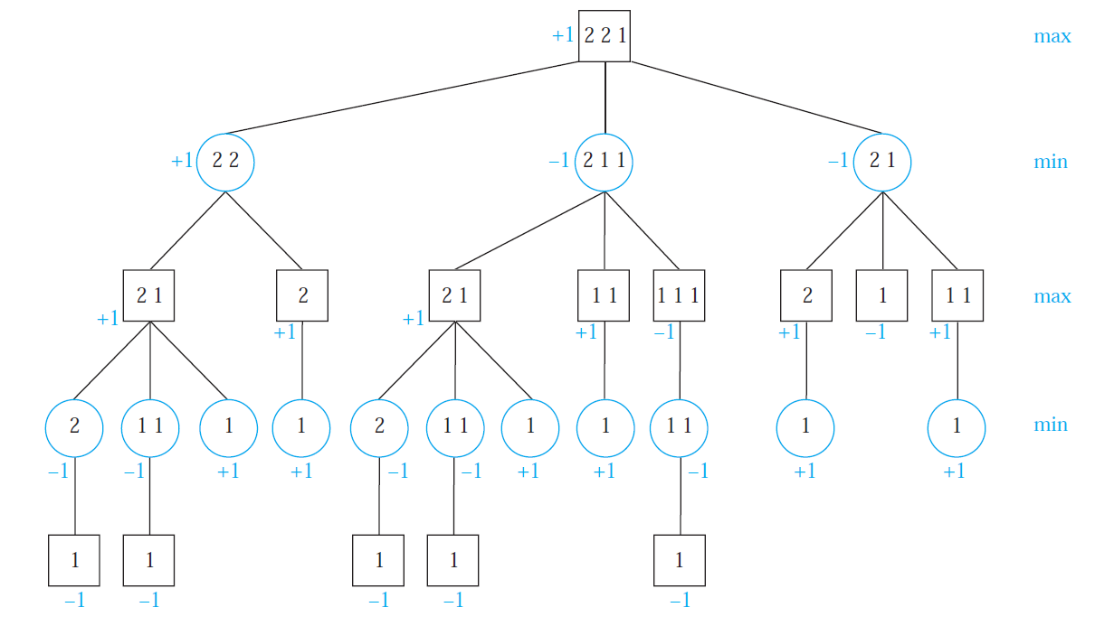

Slide 27
Game Trees
Strategy: a set of rules that tells a player how to select moves to win the game.
The minmax strategy :
the first player moves to a position with maximum value;
the second player moves to position with minimum value.

Slide 28
Theorem of Game Trees
Theorem 3: The value of a vertex of a game tree tell us the payoff to the first player if both players follow the minmax strategy and play starts from the position represented by this vertex.
Proof : If the vertex is a leaf, by definition the value assigned to this vertex is the payoff to first player.

Slide 29
Theorem of Game Trees
The inductive hypothesis is the assumption that the values of the children of a vertex are the payoffs to the first player,
assuming that play starts at each of the positions represented by these vertices.
Two case : it is the first player’s turn and it is the second player’s turn.

Slide 30
Remark:
the minmax strategy is the optimal strategy for both players.
The value of tree tell us who will win the game.

Slide 31
国际象棋有35⁸⁰个状态,
围棋有250¹⁵⁰个状态，
在密码学中, 一般认为2^¹²⁸ 就是一个机器100亿年无法数完的数字

Slide 32
Tic-Tac-Toe
Tic-tac-toe (井字棋, 三子棋) is a paper-and-pencil game for two players, X and O,
X and O take turns marking the spaces in a 3×3 grid.
The player who succeeds in placing three of their marks in a horizontal, vertical, or diagonal row wins the game.

Slide 33
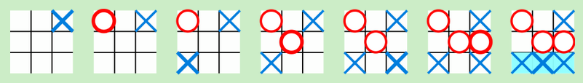
Tic-Tac-Toe
The example game is won by the first player, X

Slide 34
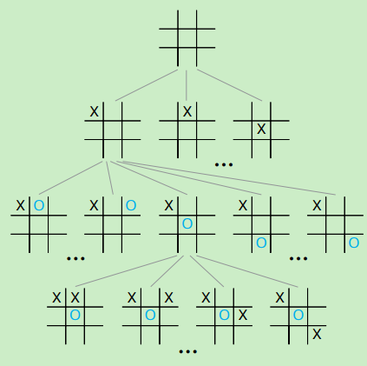
Tic-Tac-Toe
The game tree for tic-tac-toe is extremely large and cannot be drawn here.We show a portion of the game tree.

Slide 35
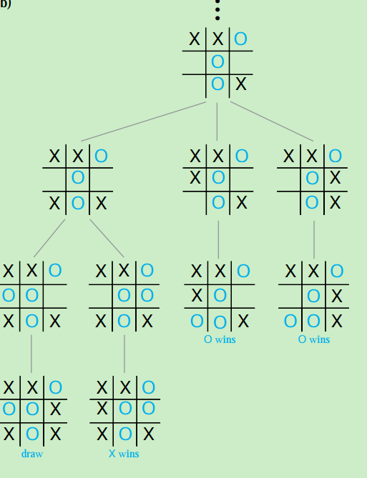
Tic-Tac-Toe
a subtree of this game tree leading to terminal positions

Slide 36
历史上的考题
1. 画出 Nim 的博弈树, 初始情况石头个数2，2，3. 计算 value of the tree.
2. 使用博弈树描述囚徒困境
两个共谋犯罪的人AB被关入监狱，不能互相沟通情况。如果两个人都不揭发对方，则由于证据不确定，每个人都坐牢一年；若一人揭发，而另一人沉默，则揭发者因为立功而立即获释，沉默者因不合作而入狱十年；若互相揭发，则因证据确凿，二者都判刑八年。

Slide 37
作业
1, 17, 19(a)

Slide 38
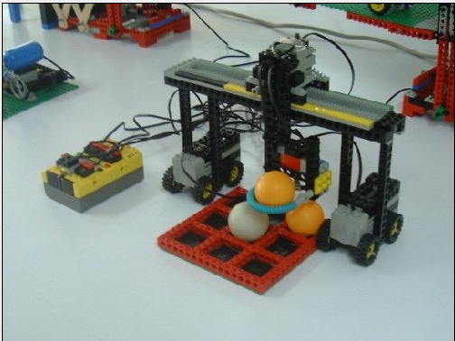
会下井字棋的机器人

Slide 39
End of Section 10.2
Click to edit company slogan .
39

